Slide 1
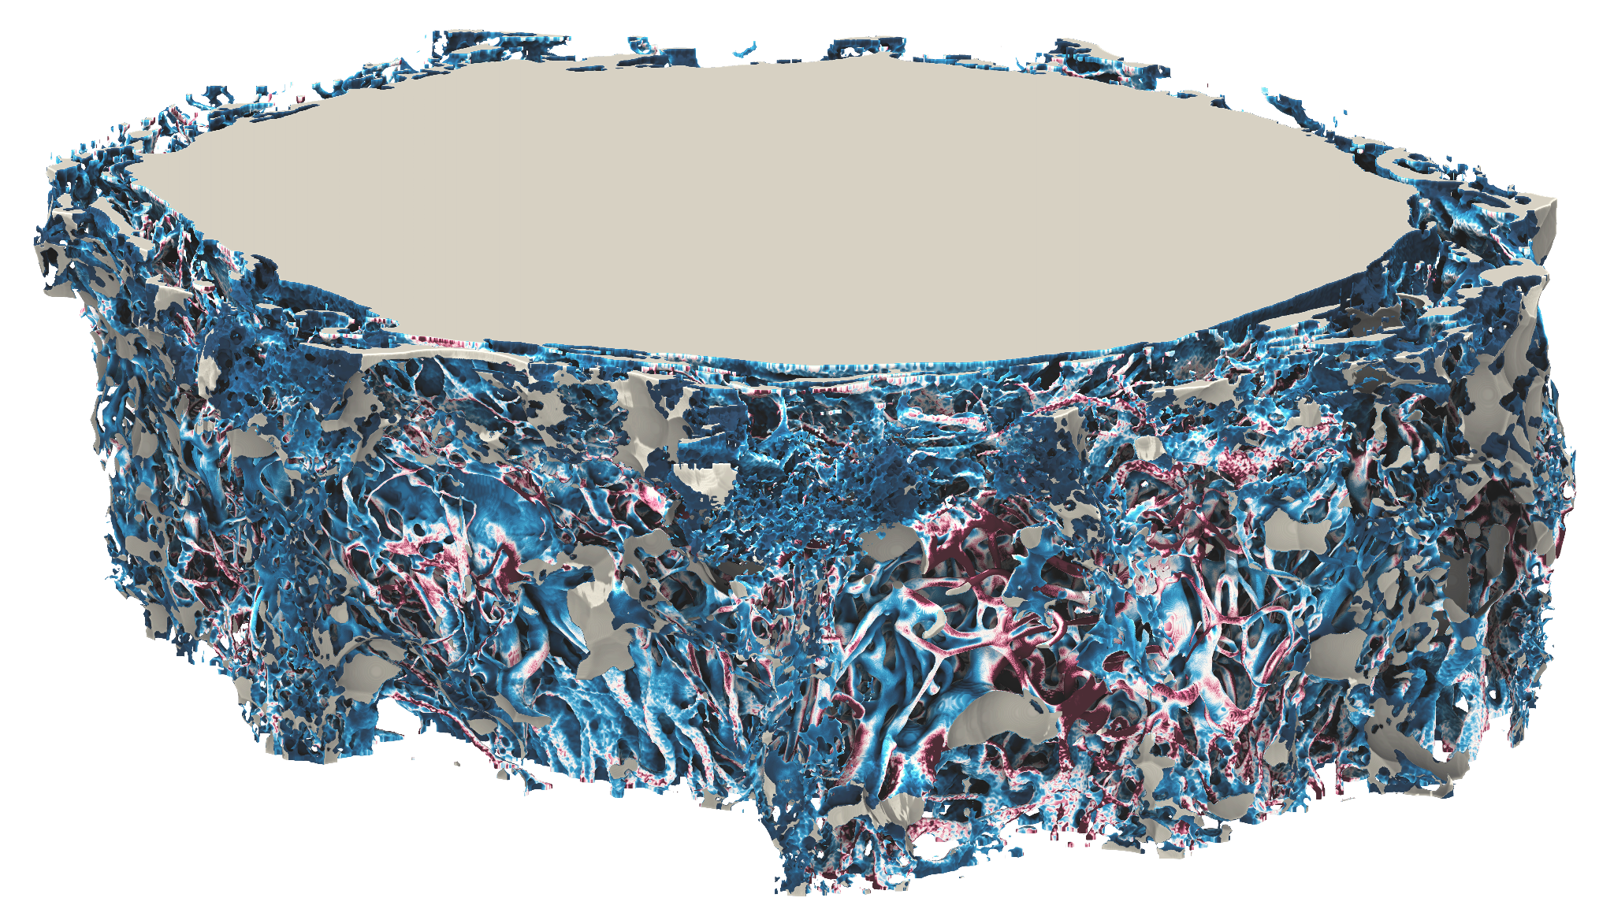
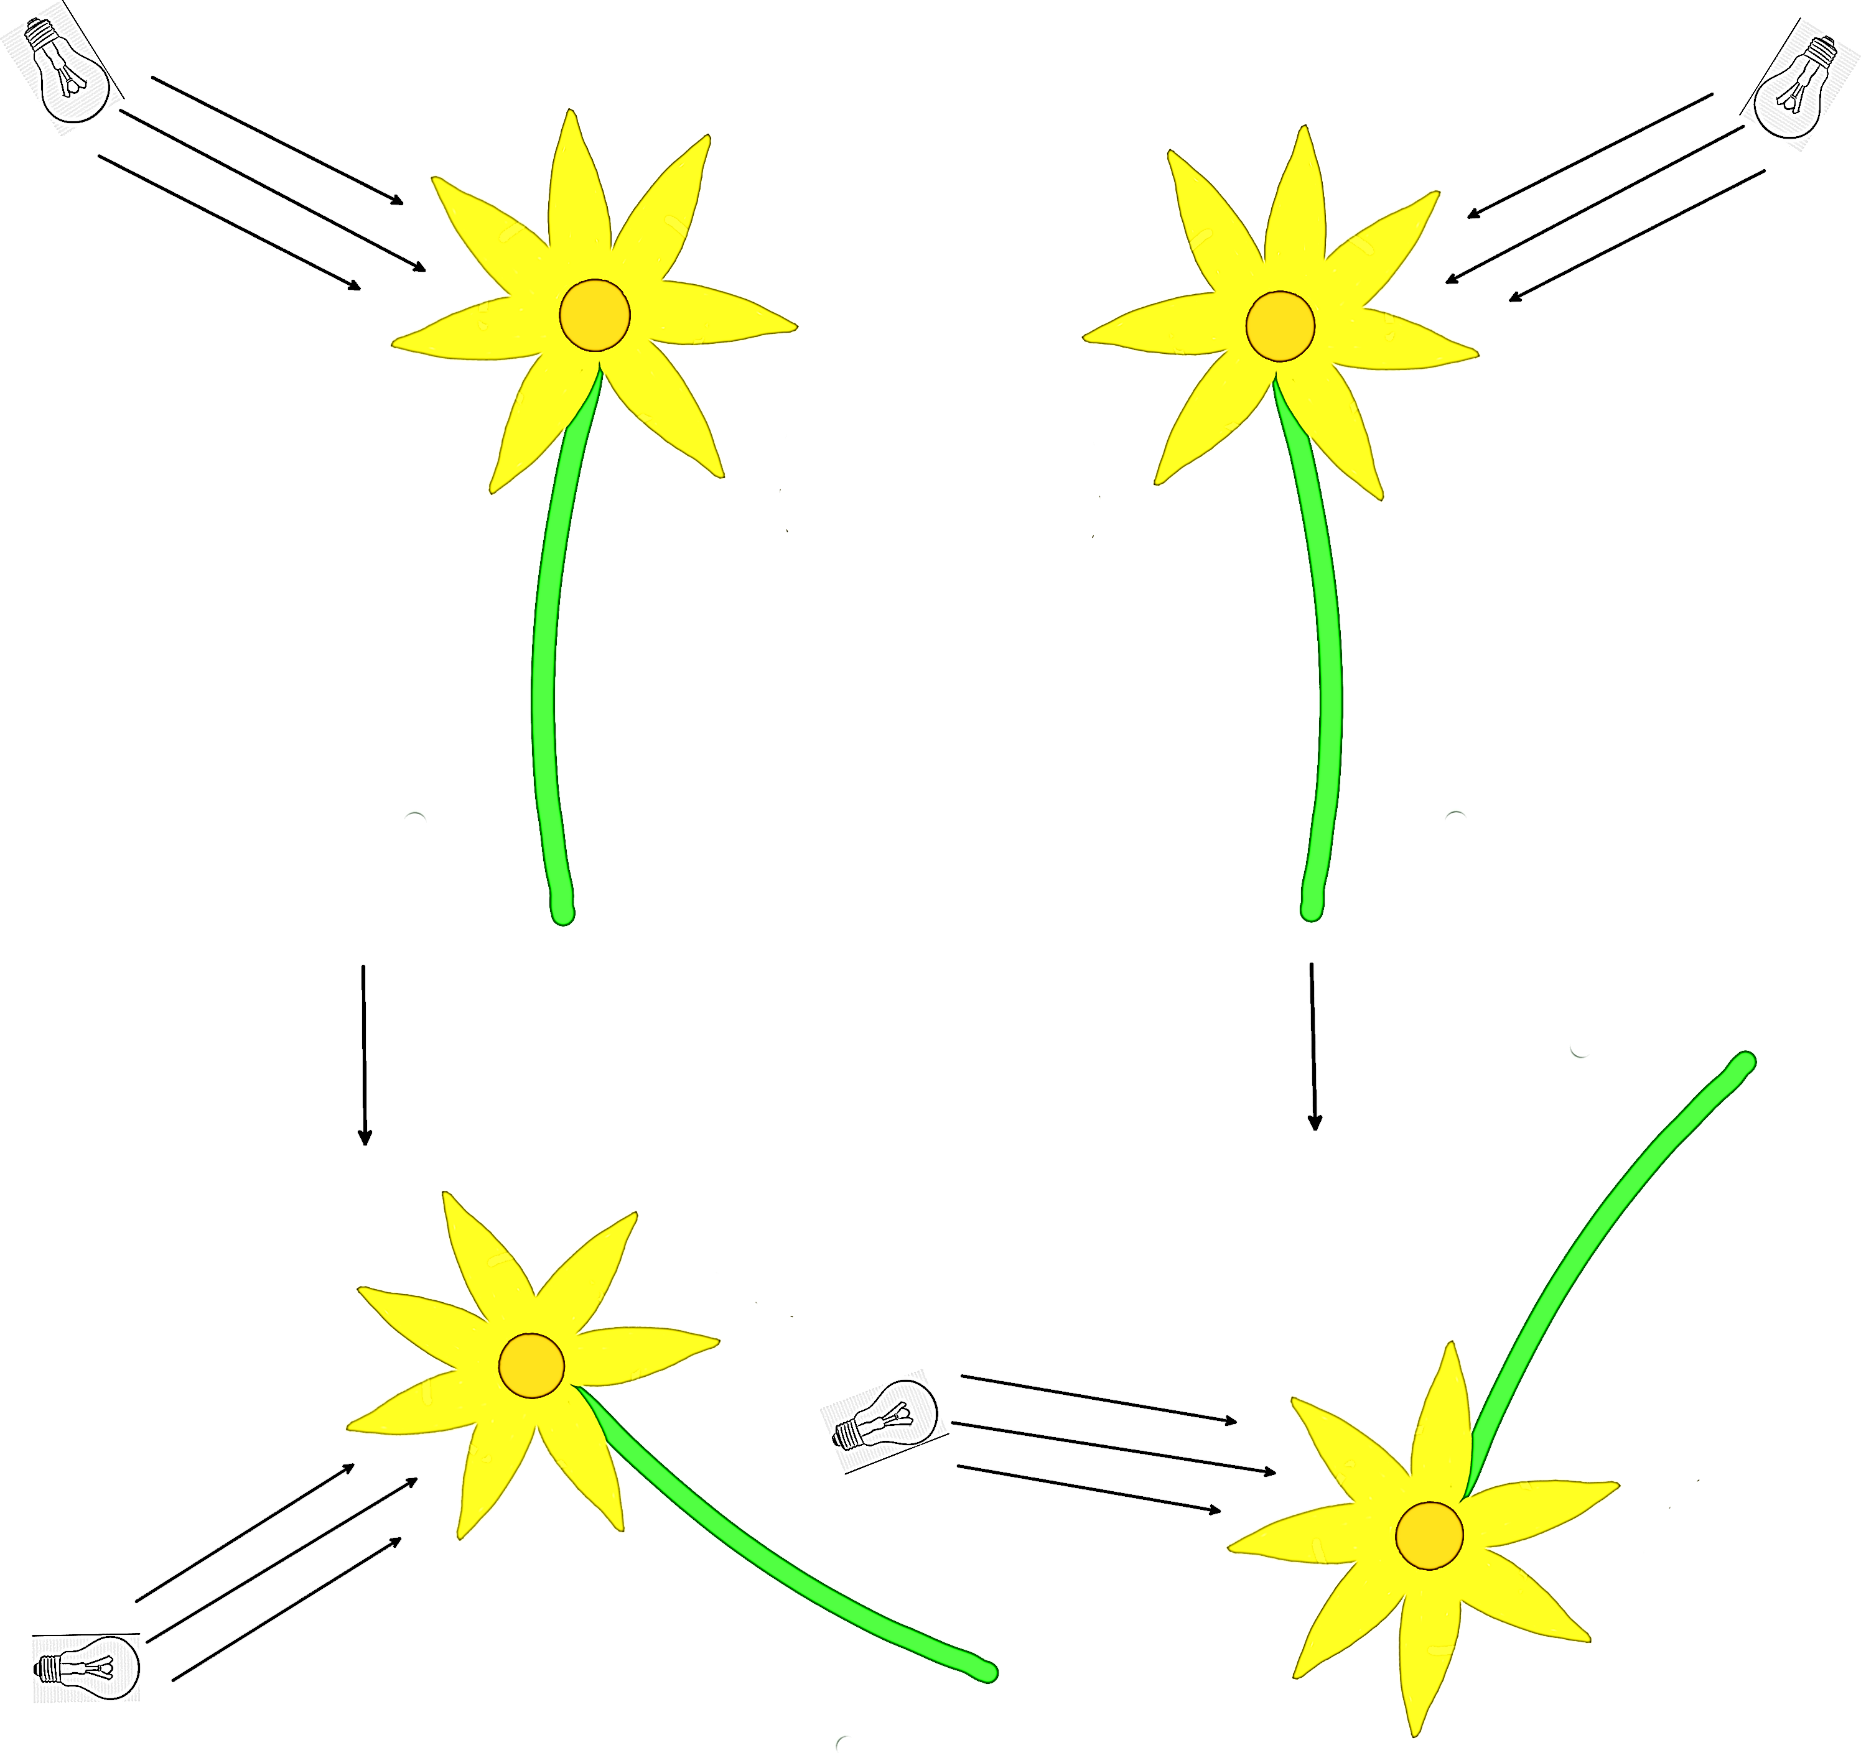
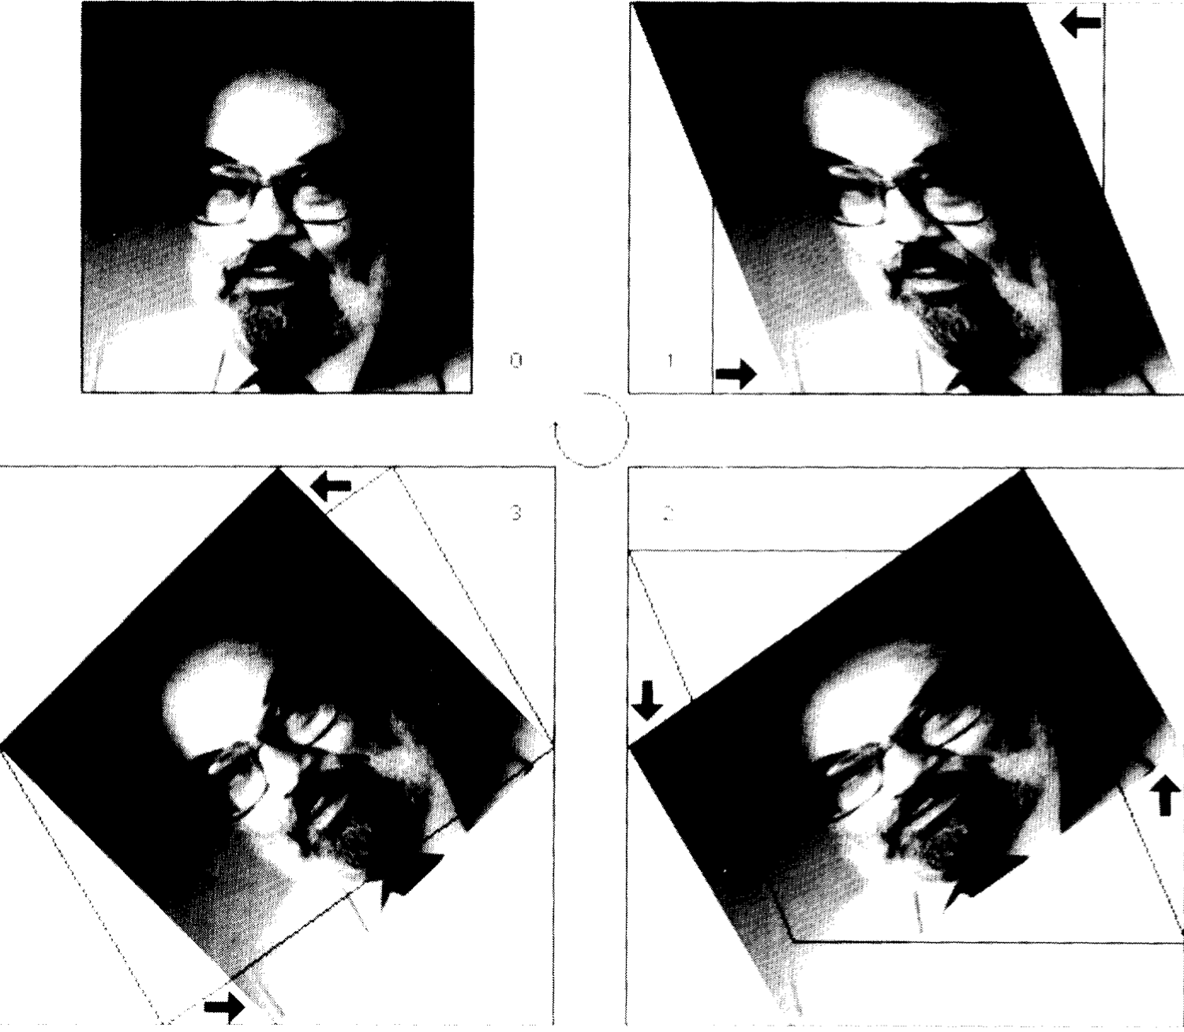
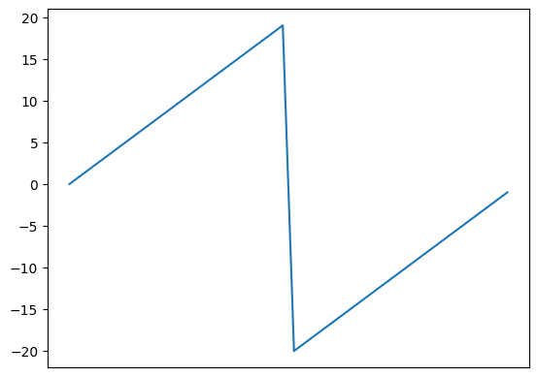
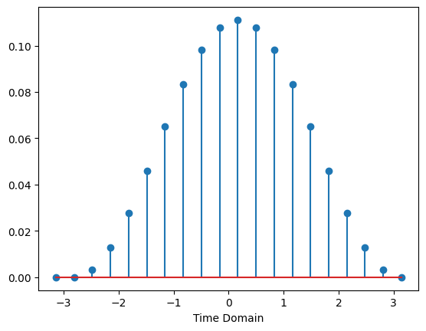

Rotation of multidimensional signals with spectral schemes
Student: Dylan Reid Ramelli
Advisor: Prof Rolf Krause
Co-Advisors: Dr Diego Rossinelli,
Dr Patrick Zulian
3D section of the optic nerve, realized with .
Light transport of high amounts of data
Motivation
3D Perception vs. Slice.
Light attenuation.
Rotation of 3D signal with high performance methods.
The goal of the project is the implementation of a numerical method to rotate a multidimensional signal while maintaining both a high degree of accuracy and performance.
Light attenuation through a model with rotation.
Three 1D translations of data
1D $translations, f\left(x−h\right)$ and data $f(x_{i})$
$f≈\sum_{i}{φ_{i}}(x_{i}−h)c_{i}→Ax=b$, global operation.
Frequency analysis
All-pass vs. Low-pass
Three-pass rotation, Michael Unser
Digital Filter Design / FIR
Property of DFT → Shift equivariant.
Fractional Shift.
Smoothing of high frequencies, local operation.

